Slide 1
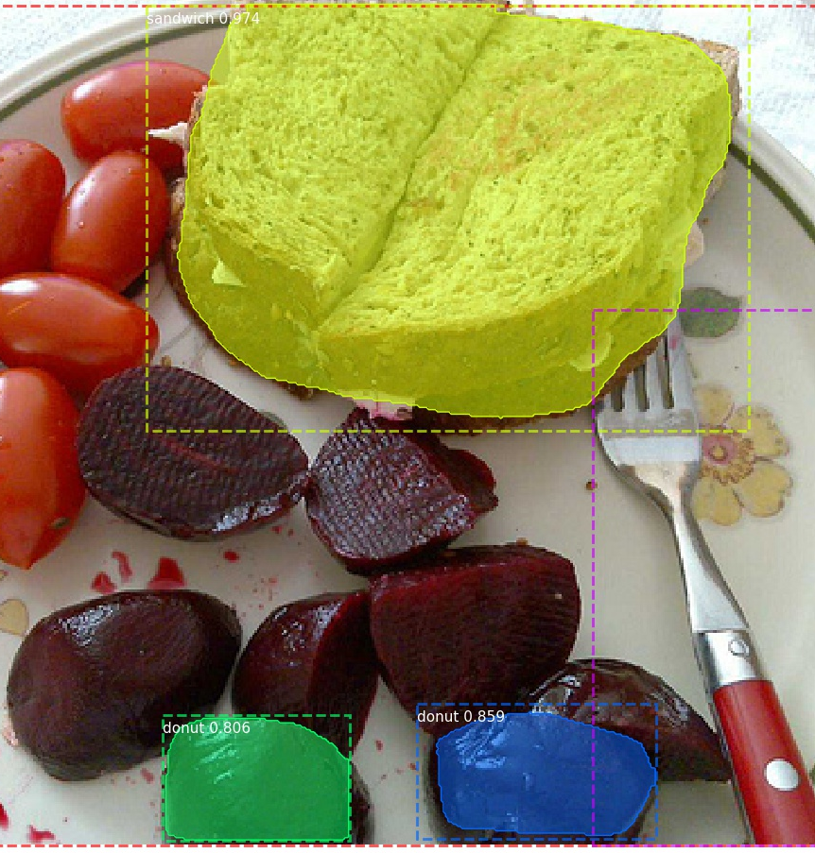
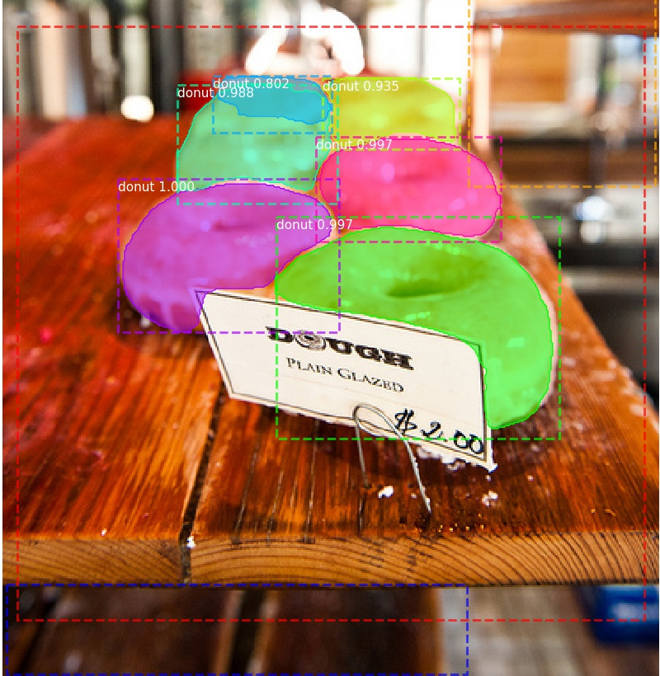
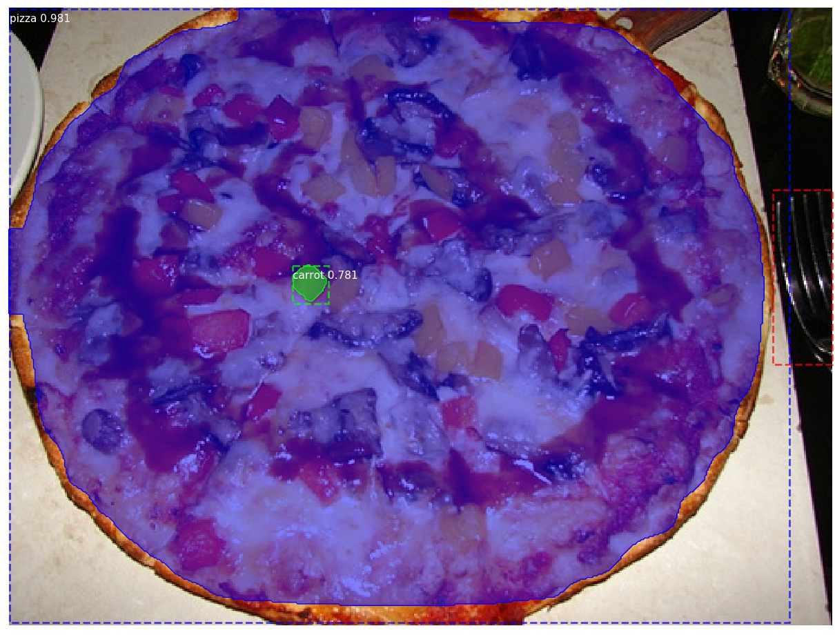
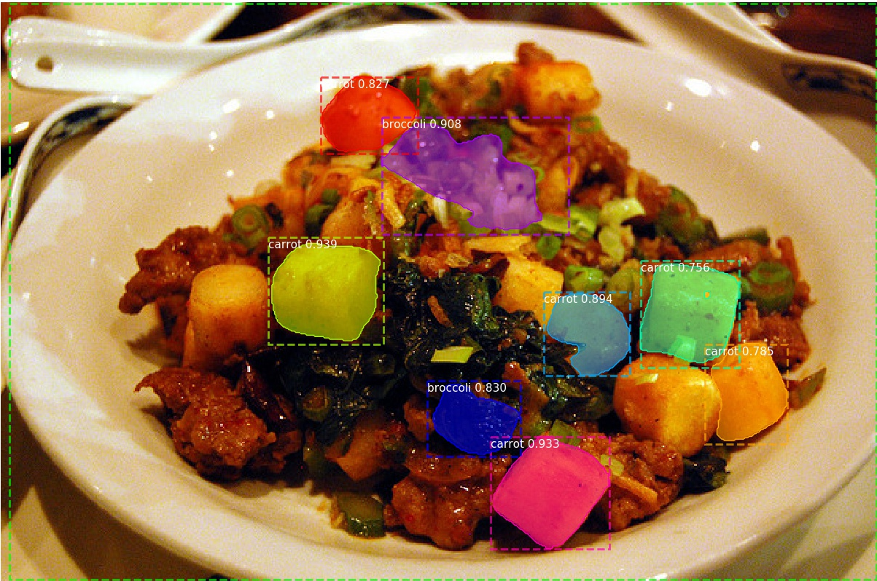
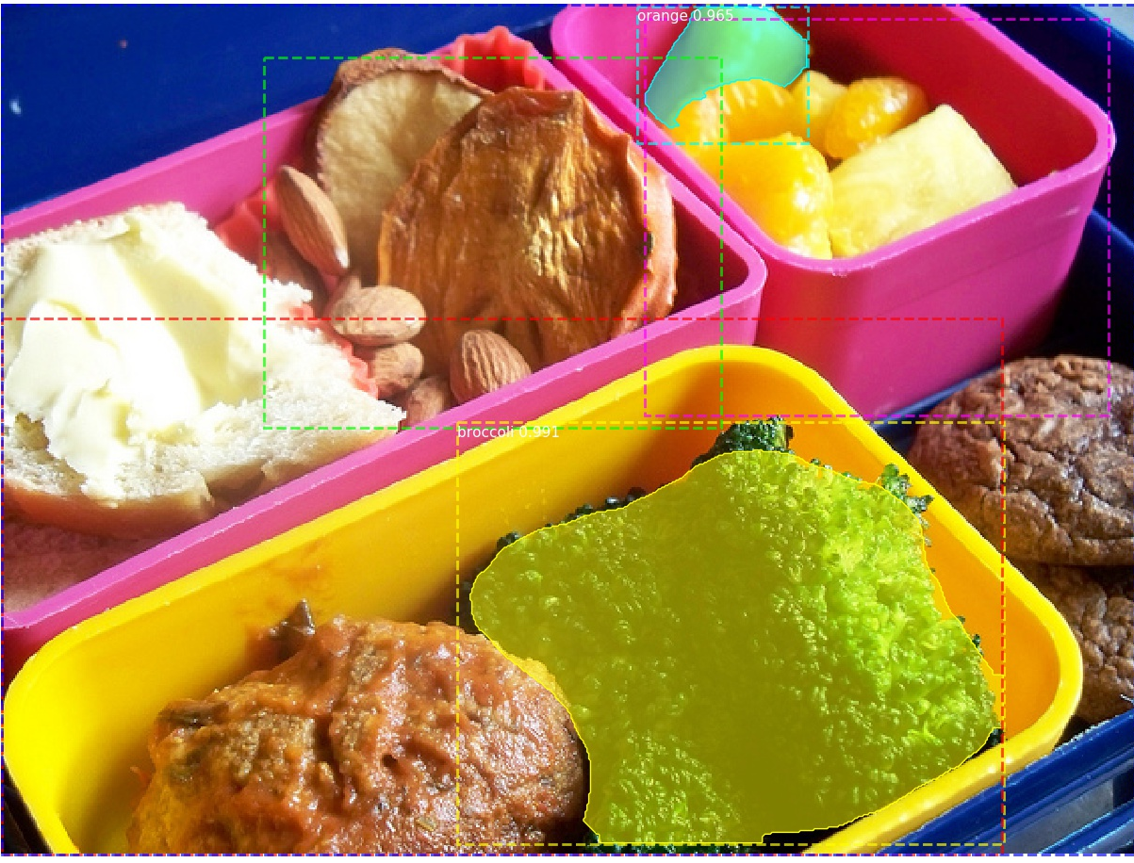
Foodify
Mask R-CNN for image segmentation
by Chintushig Ochirsukh

Slide 2
Introduction
In the past few years, there have been a number of advances in Instance
Segmentation
In COCO, there were only 5 submissions for instance segmentation as of Mar. 2018,
with 31 sub­missions for Object Detection
To review state of the art architecture in segmenting instances of images.

Slide 3
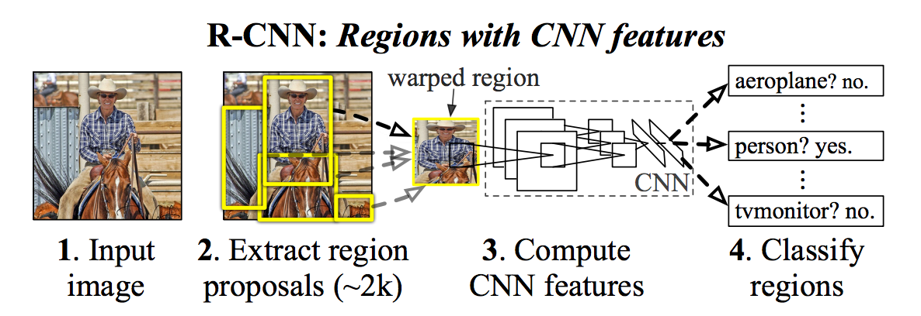
Convolutional neural network
Creates bounding boxes using Selective search
Extracts features using RoIPool from each box and performs classification and bounding box regression
Mask R-CNN is better and faster

Slide 4
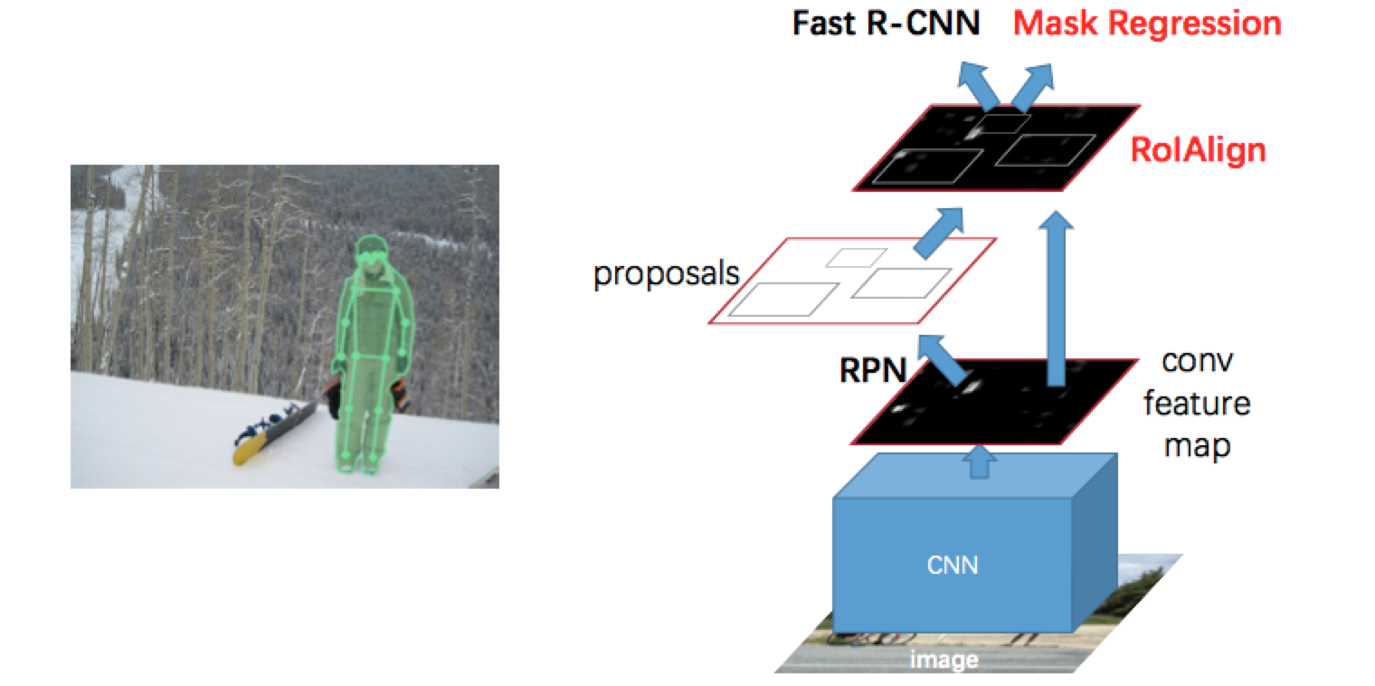
Mask R-CNN
Extended R-CNN for pixel-level segmentation
Steps:
Apply a CNN on an image to extract “Region Proposals / Regions of interest (ROI)”
Perform ROIAlign (a process to align the pixels to the original image more properly)
Perform Fast R-CNN to classify the object and find bounding box coordinates
In Parallel to #3, run another CNN to do pixel-level classification
Steps 2 and 4 are what got added.
Winner of all Microsoft COCO challenges
Winner of ILSVRC
ImageNet Large Scale Visual Recognition Challenge

Slide 5
Approach
Task
Download COCO + ILSVRC dataset
Installing Tensorflow and other supporting libraries such as Cuda or CudNN
Implement the model
Train mask regression CNN on CPU only
Train CNN on GPU
Connect to a webcam to upload frames for real-time processing.
Paper and presentation

Slide 6
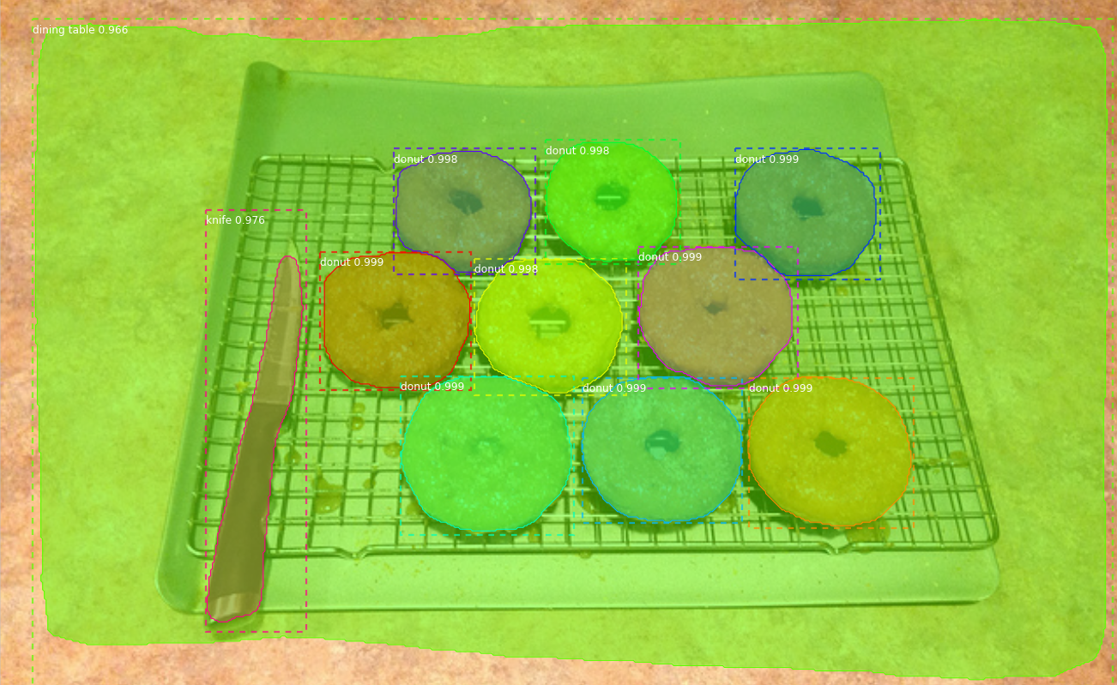
Results and Evaluation
1000 steps per epoch, max image size 800x1024
Images take 200ms to evaluate on GPU instance
Images take 7s on only cpu running machine
Learning Rate = 0.001, SGD momentum = 0.9

Slide 7
Questions?

